Slide 1
3413ICT Network Security
Lecture 4B: Intruders
Dr V. Muthukkumarasamy
Notes:
Griffith University, School of ICT
2010/1
3400ICT Information System Security
1
Griffith University, School of ICT
2010/1
3400ICT Information System Security
1

Slide 2
Previous Lecture..
We have considered:
Web security issues
SSL/TLS security protocols
SET secure credit card payment protocols

Slide 3
Today’s Objectives
To study how Intrusions can occur
To explain the concepts of various intrusion detection techniques
To understand how passwords are managed

Slide 4
References
Computer Security Principles and Practice, (2nd Edition), W. Stallings & L. Brown,
Chapters 3 & 8

Slide 5


Intruders
A significant security issue for network-based systems is hostile or unwanted access
An intruder
A party who gains access to a system without authorization, or
A authorized user acquiring privileges or performing actions beyond what had been authorized
Either via network or local

Slide 6
Intruders
Three classes of intruders:
Masquerader – Unauthorized intruder (outsider)
Misfeasor - Legitimate user (insider)
Making unauthorized accesses to data, programs, or resources – misusing privileges
Clandestine user – Outsider or Insider seizing root privilege
Intruders may use compromised systems to launch other attacks
Some solutions: Prevention, Detection, or Better Password Management

Slide 7
Protection of Password Files
An intruder can acquire information by using a stolen password
Password files should be protected in one or both of the following ways:
Access control – access to the password files is limited to one or a very few accounts
One-way function – The system stores only the value of a one-way function based on the user’s password. When the user presents a password, the system transforms the password and compares it with the stored value.

Slide 8
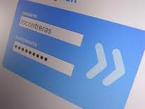
Password Guessing
An access control and/or encryption protection makes it much more difficult for a intruder to steal passwords
An attacker can still guess password:
Trying short passwords
Searching dictionaries of common words
Intelligent searches, i.e., tries passwords associated with the user (variations on names, birthday, phone, common words/interests)
etc.
Success depends on password chosen by the user
Surveys show many users choose poorly
Notes:
Password guessing is a common attack. If an attacker has obtained a poorly protected password file, then can mount attack off-line, so target is unaware of its progress. Some O/S take less care than others with their password files. If have to actually attempt to login to check guesses, then system should detect an abnormal number of failed logins, and hence trigger appropriate countermeasures by admins/security. Likelihood of success depends very much on how well the passwords are chosen. Unfortunately, users often don’t choose well.

Slide 9
Intrusion Detection
Intrusion prevention is a challenging goal – Even the best prevention system fails in many environments
Thus, second line of defense – Intrusion Detection
This has been the focus of much research in recent years
By detecting intrusions, we can
block an intrusion, if it is detected quickly
have a deterrent, so reducing or preventing intrusions
collect information to improve intrusion prevention facility

Slide 10

Intrusion Detection
Intrusion detection systems (IDS) are based on an assumption that the intruder will behave differently to a legitimate user(exam question)
However, there will be some overlap
Imperfect distinction between:
an attack by intruder and
legitimate behavior by an authorized user

Slide 11
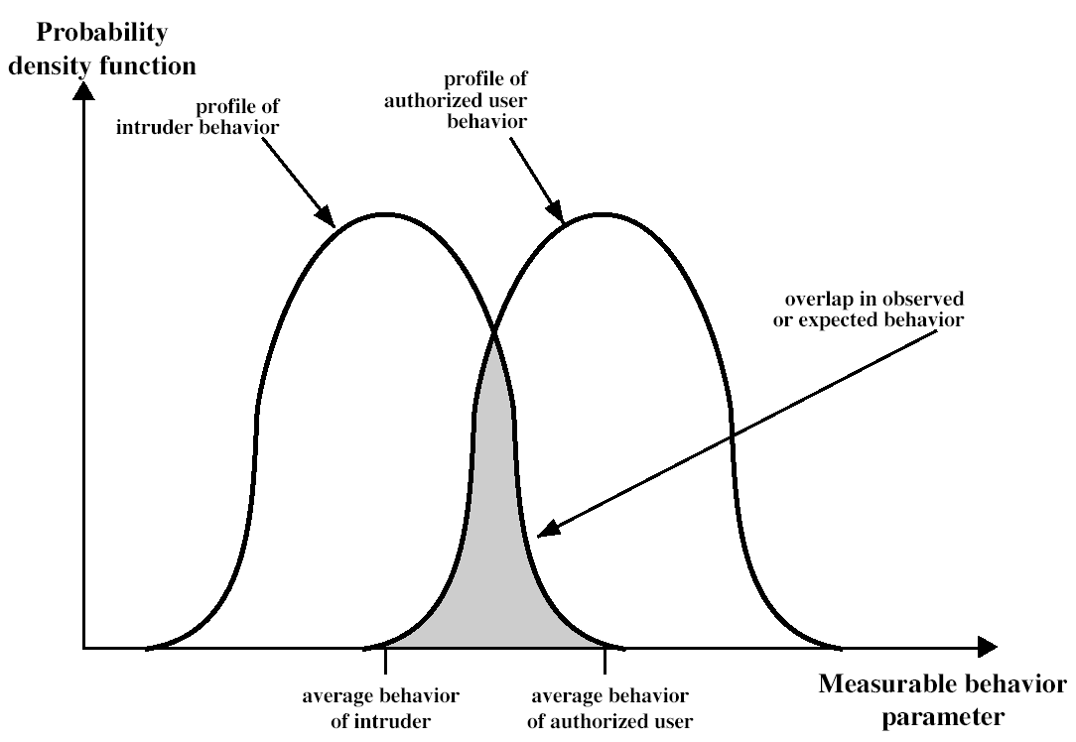
Profiles of Behaviour

Slide 12
Approaches to Intrusion Detection
Statistical intrusion detection
Threshold detection
Profile based
Rule-based detection
Attempts to define proper behavior, and detect anomaly
Penetration identification

Slide 13
Statistical Intrusion Detection
Statistical intrusion detection:
Statistically analyzing and comparing observed behavior against the behavior of legitimate users over a period of time, to determine whether the observed behavior is not legitimate user behavior
Threshold detection – defining thresholds, independent of user, for the frequency of occurrence of various events
Profile based – Developing a profile of past behavior of users, detecting significant deviations from this (Profile is usually multi-parameter)

Slide 14
Rule-based Detection
Rule-based detection:
Defining a set of rules that can be used to decide that a given behavior is that of an intruder
Anomaly detection – rules are developed to detect deviation from previous usage patterns
Penetration identification – an expert system approach that searches for suspicious behavior

Slide 15
Audit Records
Fundamental tool for intrusion detection
Native audit records
Part of all common multi-user O/S
Advantage: no additional collection software is needed
Disadvantage: may not contain needed information, or not in desired form
Detection-specific audit records
A collection facility is implemented to generate audit records required by the detection system – it can be vendor independent and applicable to multiple detection systems
Disadvantage: at cost of additional overhead on system

Slide 16
Detection Specific Audit Records An Example
A good example of detection-specific audit records contains the following fields:
Subject: The initiator of actions
Action: Including login, read, perform I/O, execute, etc
Object: Including files, programs, messages, records, terminals, printers, etc
Exception-Condition: Denotes which (if any) exception condition is raised on return
Resource-Usage: For examples, number of lines printed, number of records read or written, processor time, etc
Time-Stamp: Time-and-date stamp identifying when the action took place

Slide 17
How Statistical Detection Works
Threshold detection involves counting the number occurrences of specific event over time. If it exceeds reasonable value assume intrusion
Threshold detection by itself is crude and ineffective. It may be useful in conjunction with other techniques
Profile based detection is based on past behavior of users, and detect significant deviations from this
Foundation of this approach is an analysis of audit records
The designer decides on a number of metrics, to measure user’s behavior

Slide 18
Metrics for Measuring Behaviour
Examples of metrics for profile based detection:
Counter: Examples include: the number of logins by a single user during an interval of time, the number of times a command is executed during a single user session, and the number of password failures during an interval of time
Gauge: Examples include: the number of logical connections assigned to a user application, and the number of outgoing messages queued for a user process
Interval timer: The length of time between two related events, e.g., the length of time between successive logins
Resource utilization: Examples include: the number of pages printed during a user session

Slide 19
Approaches to Statistical Tests
Given the metrics, to determine whether the current activity fits within acceptable limits, the system performs statistical tests using one of the following approaches:
Mean & standard deviation – For each single parameter, consider its historical average and the variability
Multivariate – Considers correlations between two or more parameters (e.g., processor time and resource usage)
Markov process – Considers transitions of states (e.g., to check the transitions betweens certain commands)
Time series – Focuses on sequences of events that happen too rapidly or too slowly
Operational model – Based on a definition on what is considered as abnormal
Notes:
cf. Stallings Tale 18.1 for examples of various metrics and models.

Slide 20
Rule-Based Intrusion Detection
It observes events on system & applies a set of rules to decide if activity is suspicious or not
Examples of rules that are used in rule-based intrusion detection:
Users should not read files in other user’s personal directories
Users must not write other users’ files
Users who log in after hours often access the same files they used earlier
Users do not generally open disk devices directly but rely on higher-level operating system utilities
Users do not make copies of system programs
……

Slide 21
Distributed Intrusion Detection
Traditional IDS focuses on single systems
But we have networked systems
A more effective defense has these working together to detect intrusions
Issues
Dealing with varying audit record formats
Integrity & confidentiality of networked data
Centralized or decentralized architecture

Slide 22
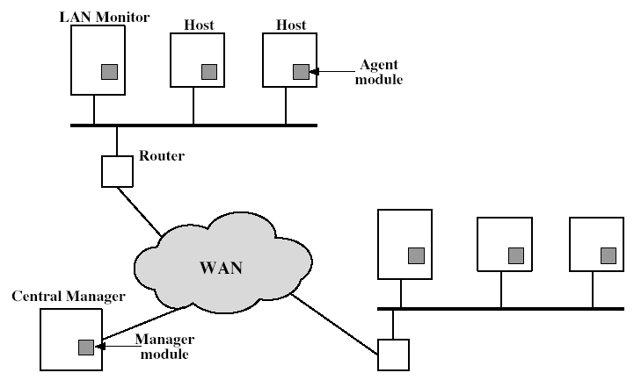
Distributed Intrusion Detection - Architecture
Notes:
Stallings Fig 18-2.

Slide 23
Honeypots
It is a decoy system to lure attackers. Honeypots are designed to
divert an intruder away from critical systems
collect information of their activities
encourage attacker to stay on system long enough for administrators to respond
Are filled with fabricated information
Instrumented to collect detailed information on attackers activities
May be single or multiple networked systems

Slide 24
Password Management
Front-line defense against intruders
Users supply both:
ID – determines privileges of that user
Password – to identify them
Passwords often stored encrypted
Unix uses multiple DES (or variant with salt)
Crypto hash functions are used in other systems

Slide 25
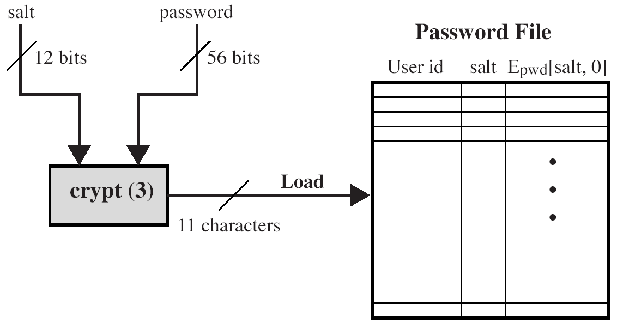
Password Management
E<salt+password>
encryptions & radix-64 encoding

Slide 26
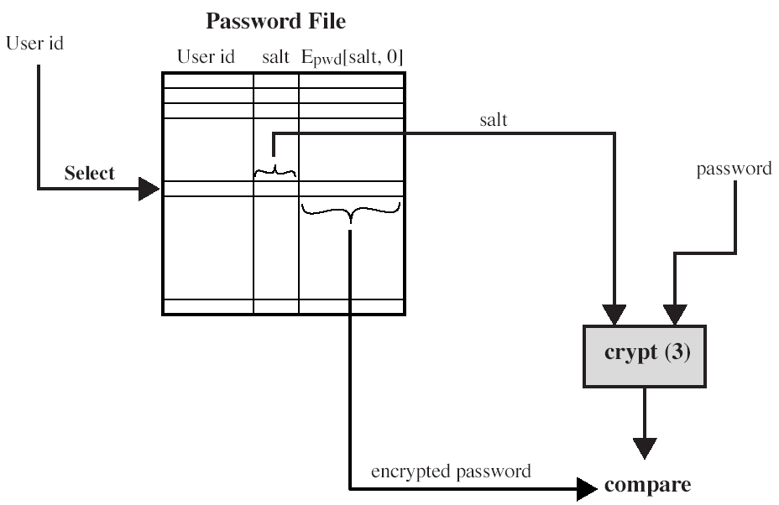
Password Management Verifying A Password
(Stallings Fig 18.4b)

Slide 27
Password Policies
Need policies and good user education
Ensure every account has a default password
Ensure users change the default passwords to something they can remember
Set technical policies to enforce good passwords
Minimum length (>6)
Require a mix of upper & lower case letters, numbers, punctuation
Avoid to use known dictionary words
Notes:
Have a range of possibilities for helping users generate "good" passwords, but need their cooperation.

Slide 28
Good / Bad Passwords ?
Establish a dictionary of possible “bad” password
However, it must be very large
Comparing the given password with words (one-by-one) in the dictionary could be very inefficient
Instead, can use more efficient techniques, such as Markov Model

Slide 29
Markov Model for Password Checking
As an example, look at a simplified Markov model for password checking
Given a state space A, which is the alphabet for making password, generate a matrix of transition probability, T.
For example, A={a, b, c}.
Based on the dictionary of bad passwords, T is as follows, for example:
Given a password, e.g., cabcab, consider the probabilities of its bigrams in the dictionary of bad passwords – can easily find whether or not it is a good password.

Slide 30
Summary
In this class, we have studied:
Problem of intrusion
Intrusion detection (statistical & rule-based)
Password management

Slide 31
Next Lecture
Malicious Software & Firewalls

Slide 32

Questions?
32

